Slide 1
MoMo Talent 2024 Data Analytics Trainee
Case Study
Candidate name: Bạch Ngọc Minh Trúc
Candidate password: mt472mh4bo
Date: 16/6/2024
Link Git: https://github.com/BNMT/5_Momo2024_CaseStudy

Slide 2
Part A: Data Processing
(10 points)

Slide 3
Part A
Question | Answer | Excel file data location (sheet/cell)
1) Total revenue in January 2020: | 53.814.234 | Cell 14 – Jupyter NB
2) Most profitable month: | September (63.400.000) | Cell 15 – Jupyter NB
3) Day of week (most money): | Wednesday (55.012) | Cell 16 – Jupyter NB
3) Day of week (least money): | Sunday (48.990) | Cell 16 – Jupyter NB
4) Total number of New users in Dec 2020: | 1.460.000 | Cell 19 – Jupyter NB

Slide 4
Part B: Data Visualization
(10 points)

Slide 5
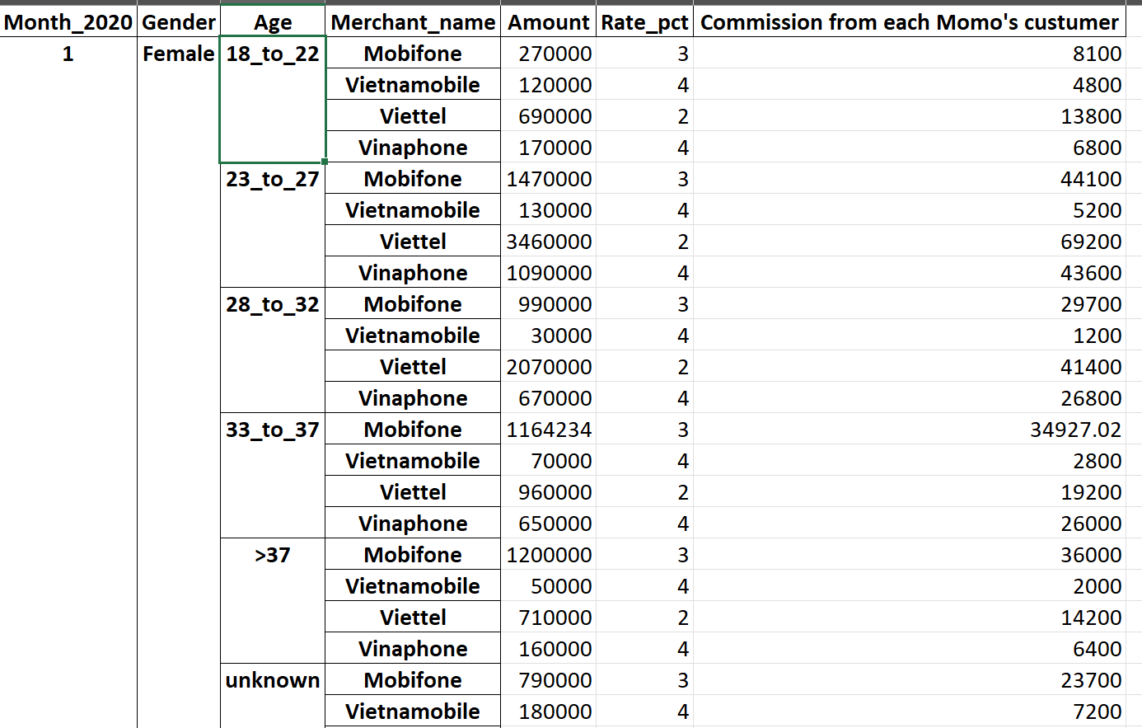
Part B: Q5: Performance Dashboard
5.1 Visualize with table
The table is built on customer segment, such as: month, gender, age, merchant. Using this table, we can see the commission which Momo received from each catergorize of customer market. For example, in January 2020, Momo was earning 8.100 vnd when selling the revenue of Mobifone cards being 270.000 vnd for those teen girls from 18-22.
Note:
The result file is in “table_chart.xlsx”.
The process to create this table is in file “Momo talent 2024_case study.ipynb”
Notes:
The result file is “table_chart.xlsx”

Slide 6
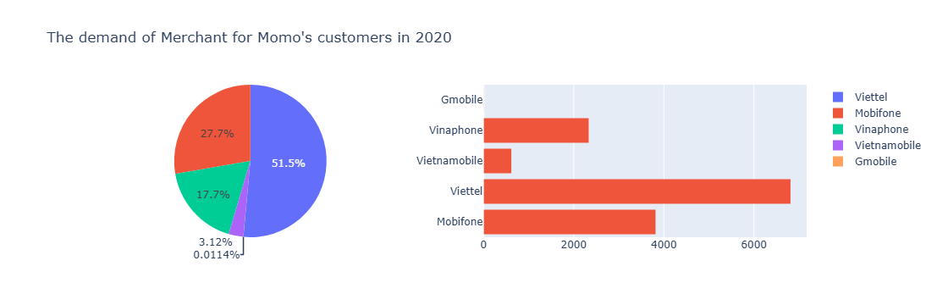
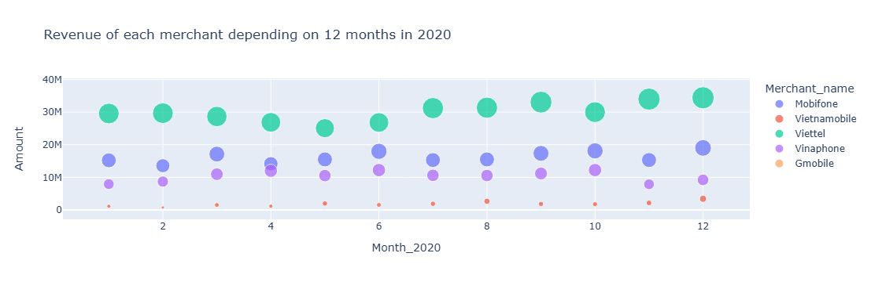
Part B: Q5: Performance Dashboard
5.2 Visualize with color charts
In general, both the quantity and revenue of Viettel cards is the highest with more 360 million vnd and more 6.800 cards, taking more 51% in comparasion to the total. Following this, the second position is Mobifone with more 194 million vnd and 3.800 cards. Contrarily, there are 3 merchants having the least amount of sale: Vinaphone with more 17%, Vinamobile with more 3% and Gmobile.
Particularly, if we appriciate the sale depending on 12 months, the trends won’t differ from that of the year 2020. It means that the rank of turnover of 5 merchants in month statistics is direct proportion with that of the year.
Moreover, we easily see the interesting fact that Viettel is the merchant getting the highest amount, Momo takes 2% commission rate; Mobifone is 3%; and the remainings is 4%.

Slide 7
Part C: Analysis & Business Insights
(10 points)

Slide 8
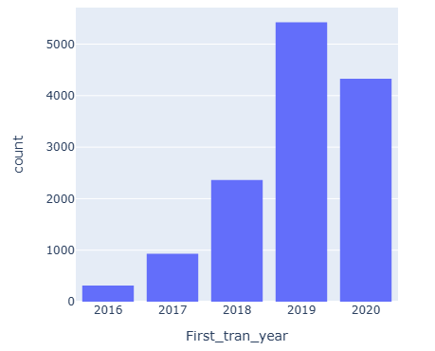
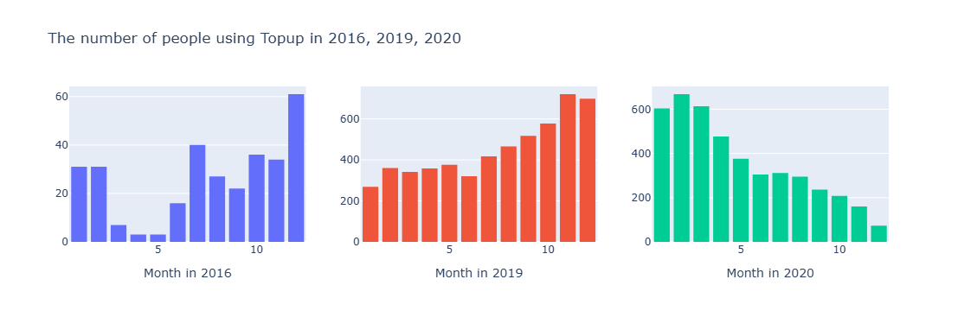
Part C: Q6
6.1 Transaction behavior
According to picture 1, we can say that,
2016 is the first year when people start using Topup, so Momo had the least amount of users in that year.
Until 2019, it is the time when the Covid-19 was incurred, people must have kept distance in meeting and even not using cash. As the result, the number of users had been raised dramatically.
In picture 2,
- In the second half of last year 2020, the stress of pandemic in Vietnam had been decreased and people could have traded directly which leads the cash using habitat was returned gradually.

Slide 9
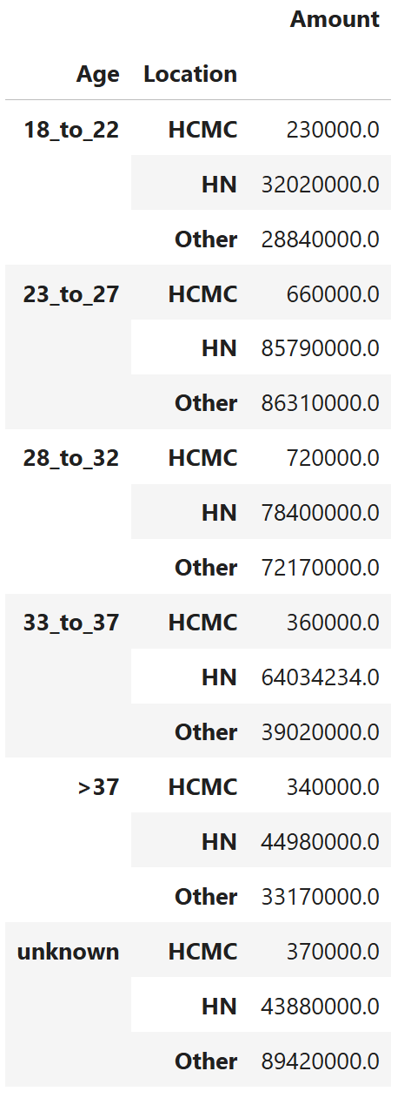
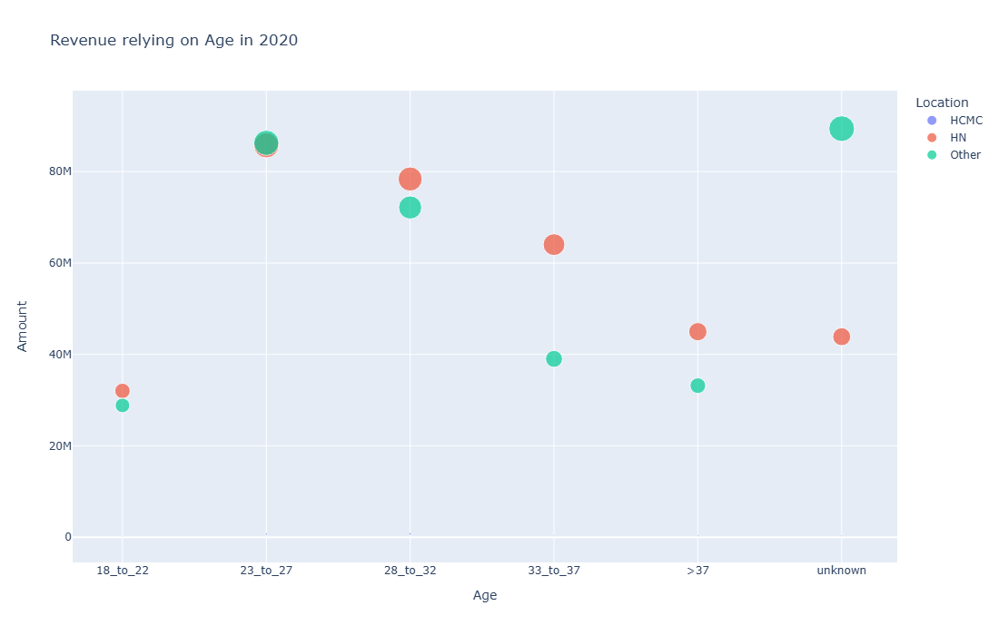
Part C: Q6
6.2 User demographics
The number of those who uses Topup in HCMC is so small that it’s hard to perform in the bubble chart. Besides, the Hanoi’s dwellers are seem to love Topup service. The chart shows most of age’s groups living in Hanoi would like to buy mobile cards by Momo.

Slide 10
Part C: Q7
Some advice for the Marketing department in designing promotion campaigns to increase Topup's monthly performance
Because of the large difference between Topup’s turnover in HN and HCMC (both cities are densely-populated), I suggest that the Marketing department should figure out why people in Ha Noi pay most interest in Momo service instead of others, and then applying those experiences to other cities and provinces.
For example: people in Ha Noi are accustomed to Momo thanks to advertisements or promotion, why coupons do not attract those living in Ho Chi Minh, whether users miss these coupons.
Try to understand people’s upset while using other Momo services. Because when people feel that they do not receive as many benefits in other services as before, they can also reduce using Topup.

Slide 11
Part C: Q8
MoMo is considering deducting a part of revenue to increase cashback for users in all Telco merchants. How does this affect the service?
I agree with your opinion.
In the viewpoint of small businesses or retailers, most of them would like to make profit basing on selling the quantity of products. The more quantity you sell, the more profit you get. Furthermore, with lower price or more cashback, you attract the people’s loyalty to your services again frequently. A long time later, this will turn into a common behavior and habit. Second, when you owns the people’s love, they will introduce efficiently you to their family, friends, colleagues, … and you won’t need to pay for advertisements anymore.

Slide 12
Part C: Q9
Other Topup development strategy ideas
- Create or build up a small game in which after people come to play and earn point, they will have redeemed points into discount tickets for only buying phone cards or data cards. If this program is incurred, you can take a bit of amount of fund in question 8 to remain the game or even you won’t need to increase cashback.

